Slide 1

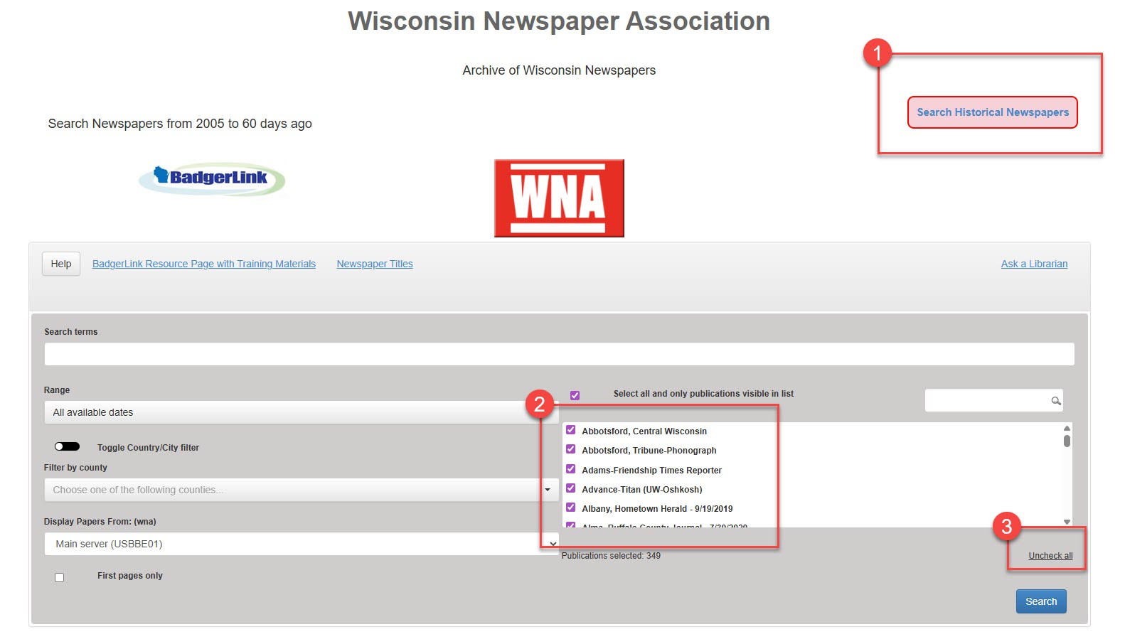
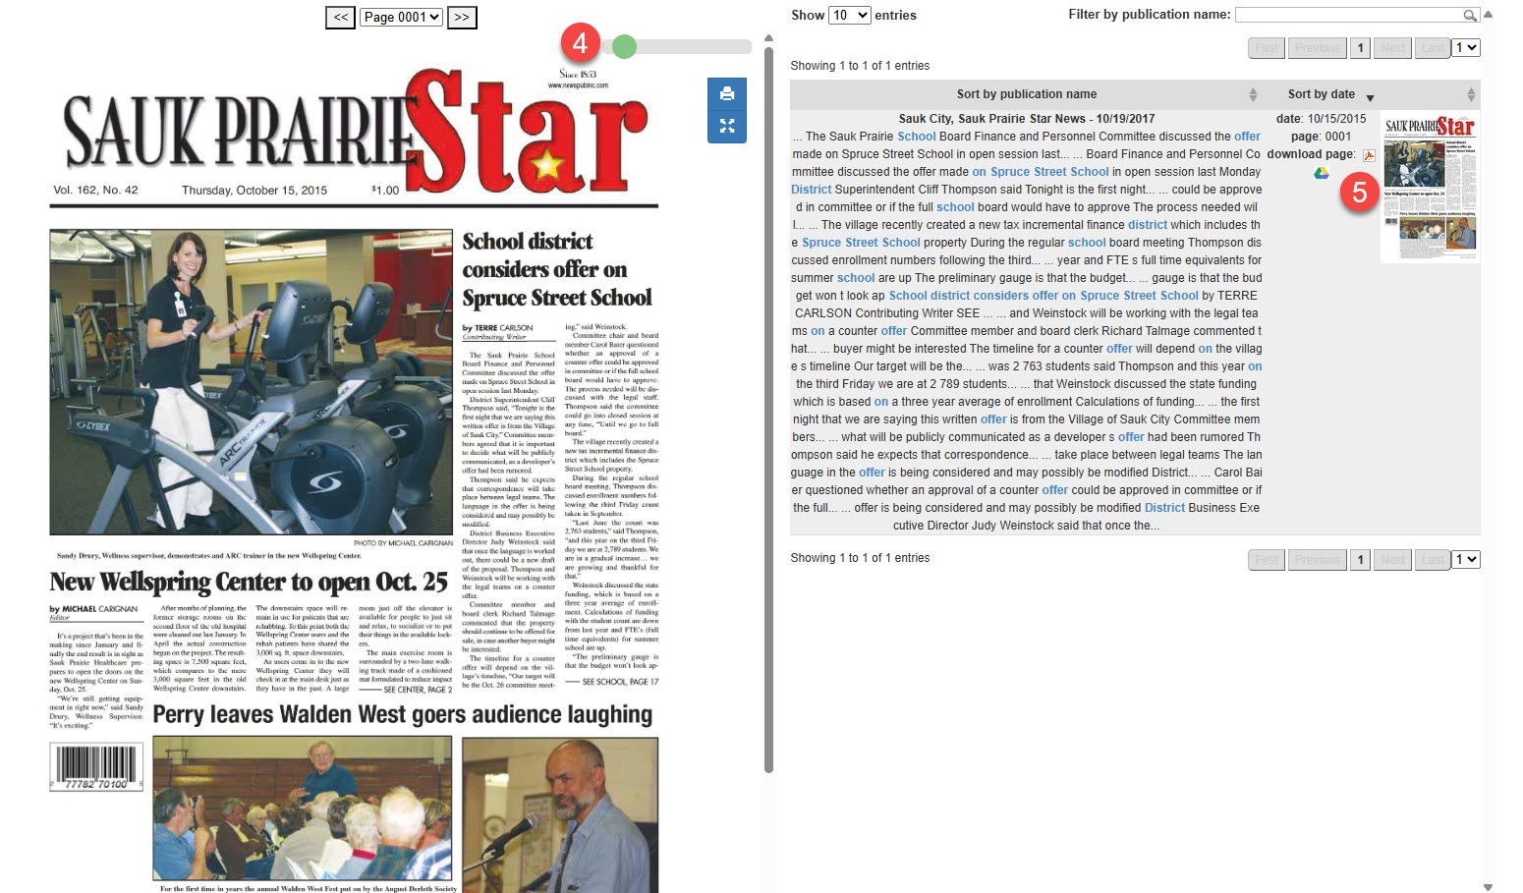


Archive of Wisconsin Newspapers Full text daily and weekly Wisconsin newspapers from 2005 to 60 days ago, plus newspapers from the 1800s and 1900s.
1. On the home page, newspapers from 2005 to 60 days ago will be searched. If you wish to search historical newspapers, click Search Historical Newspapers button in the upper right corner.
2. Lower down the page, all newspaper titles are selected to be searched by default.
3. If you do not want to search all newspaper titles, remove checkboxes from all newspaper titles by selecting Uncheck all.
4. Search results display below the search interface. A zoom tool is in the upper right corner of the viewer displaying the newspaper page from search results list.
5. In the text to the right of image, select icons to download page to PDF format and add to your Google Drive.
Provided by the Department of Public Instruction. Funding provided through the Universal Service Fund and the Institute of Museum and Library Services.

