Slide 1









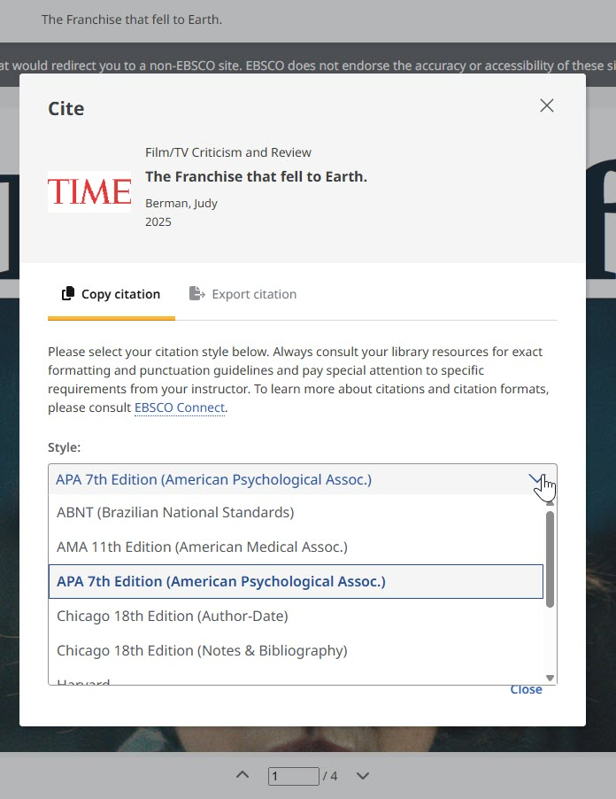
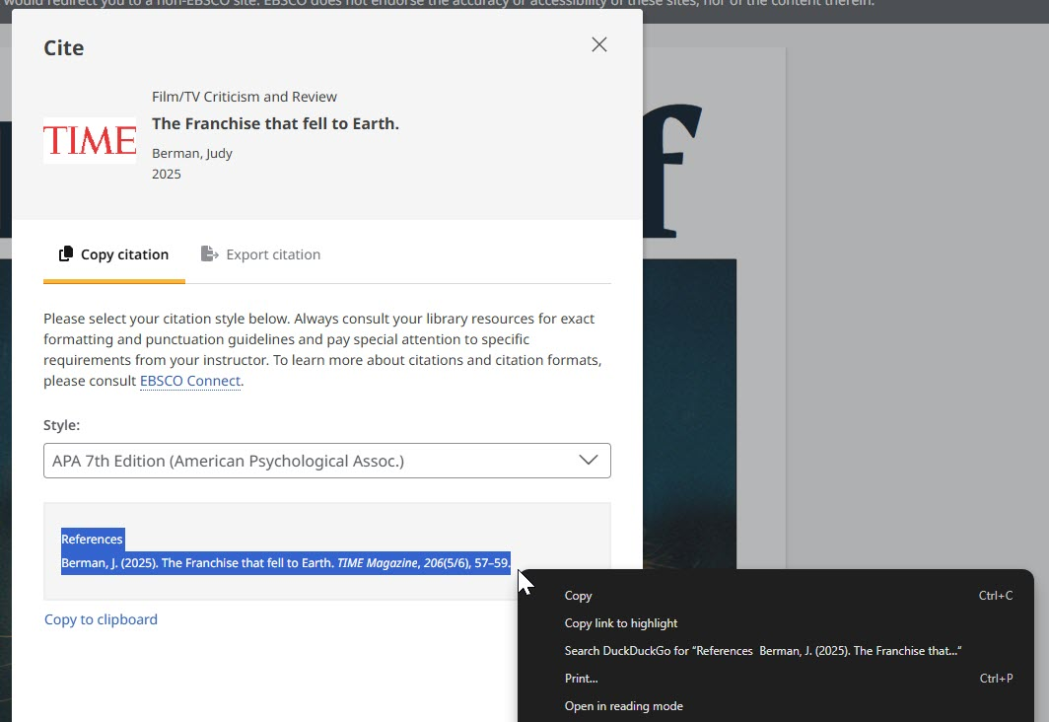


Citation Tools in BadgerLink Resources
Many BadgerLink resources have a citation tool, making it easy to cite sources you find and use in your research, homework, presentations, and written communications.
Select the Cite icon in the article toolbar in each of these BadgerLink resources.
Some resources’ cite tools have multiple options of citation styles to use.
Select Copy to Clipboard, right click, or ctrl C to copy and paste the citation to your reference list.
Provided by the Department of Public Instruction. Funding provided through the Universal Service Fund and the Institute of Museum and Library Services.

