Slide 1

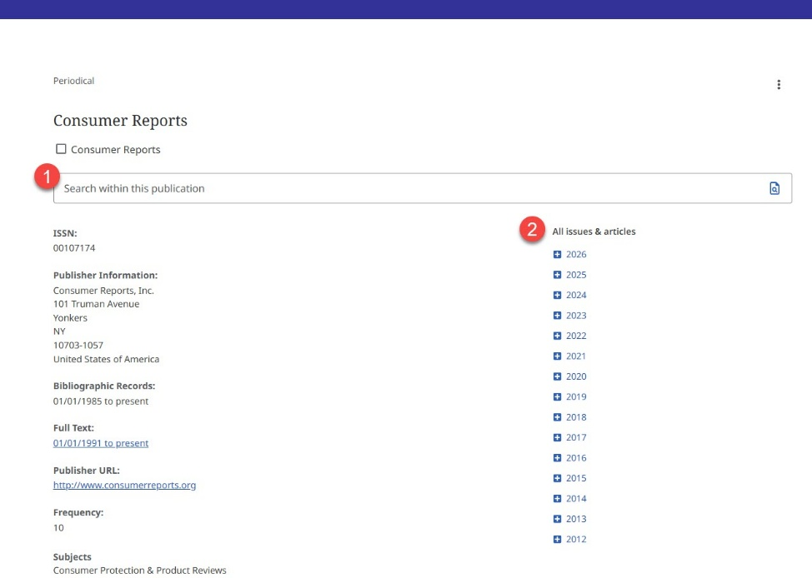

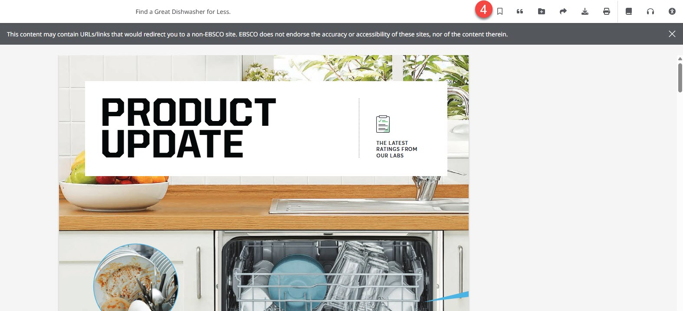


Consumer Reports Magazine
Full text, PDF version of the popular consumer magazine. Find information on hundreds of consumer products. Articles include images, graphs, and charts in full color from 1991 to present.
1. From the Consumer Reports publication page in MasterFILE Complete, search within the publication by typing in any terms in the top search box.
2. Browse by issue by selecting the year and date in the list on the right side of the page.
3. When searching in the publication, JN “Consumer Reports” will be automatically added to your search of keywords.
4. Select icons in the upper right of the article page to save, cite, share, download, and listen to the articles read aloud.
Provided by the Department of Public Instruction. Funding provided through the Universal Service Fund and the Institute of Museum and Library Services.

