Slide 1


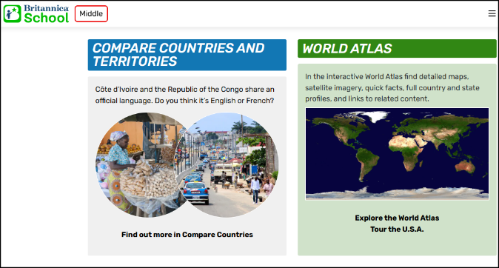
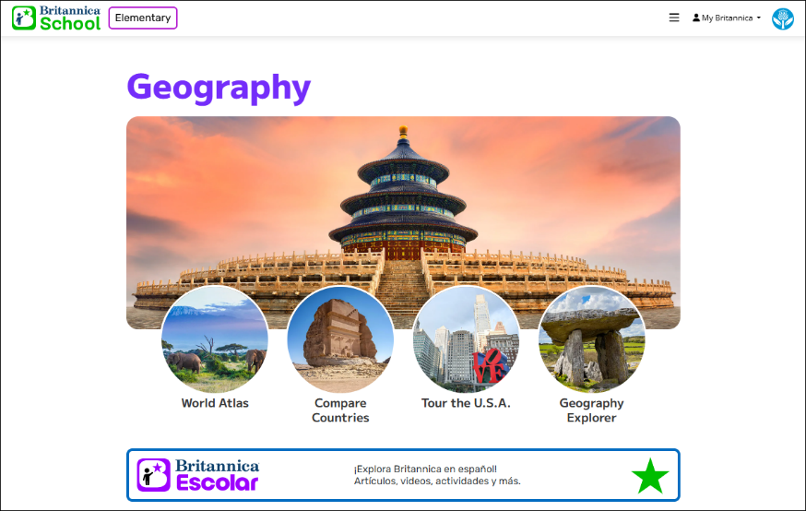
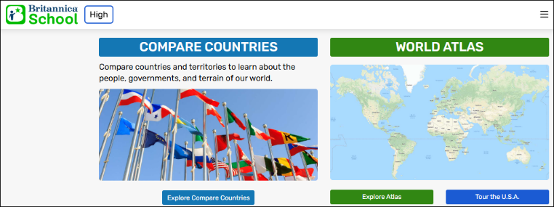

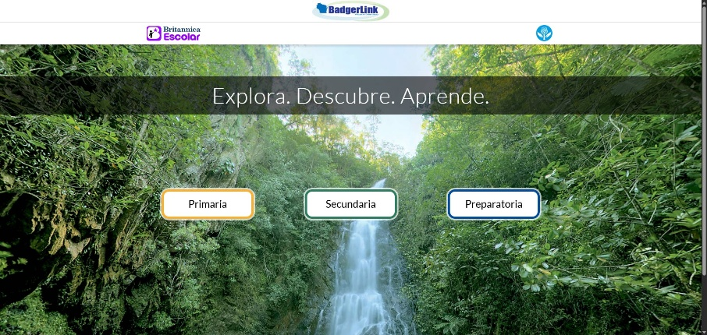


Countries and Cultures Resource Guide BadgerLink’s Britannica resources have features for researching countries and cultures. There is also a resource completely in Spanish.
Britannica School
Compare Countries and World Atlas tools allow students to explore different regions and countries of the world. Articles then connect students with encyclopedia information on cultures and traditions of each country. These tools are found on the home pages of all levels of Britannica School.
Details and how to use.
Britannica Escolar
Enciclopedia español para los estudiantes más jóvenes y educadores. - Spanish encyclopedia for all grade levels of students.
Incluye artículos, imágenes, mapas, tablas, líneas de tiempo , así como un diccionario completo y atlas - Includes articles, images, maps, tables, timelines, as well as a complete dictionary and atlas. Details and how to use.
Provided by the Department of Public Instruction. Funding provided through the Universal Service Fund and the Institute of Museum and Library Services.

