Slide 1

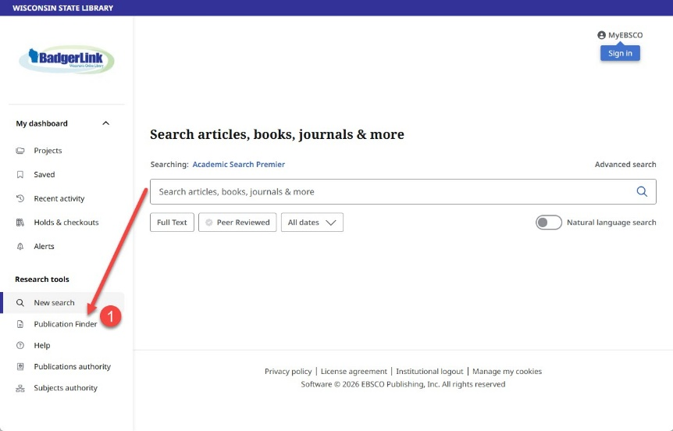
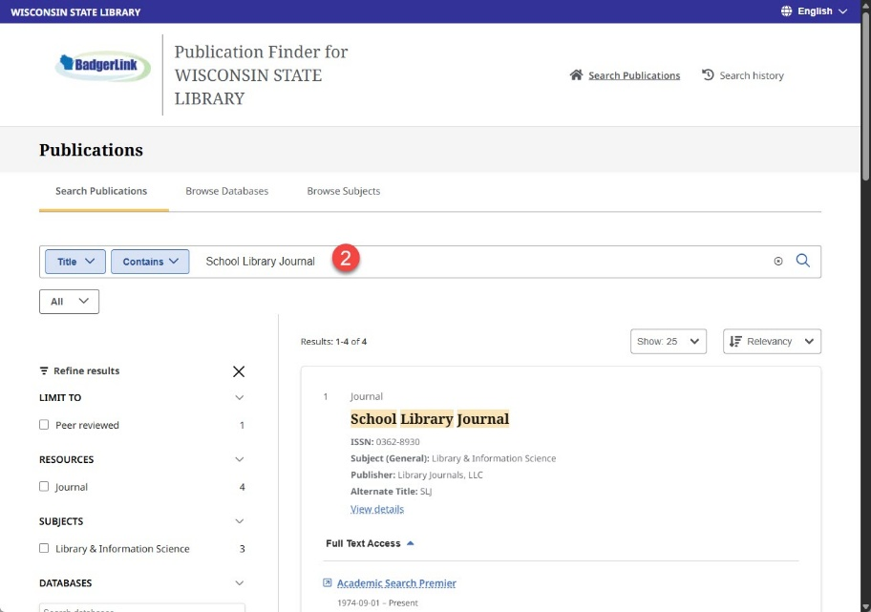
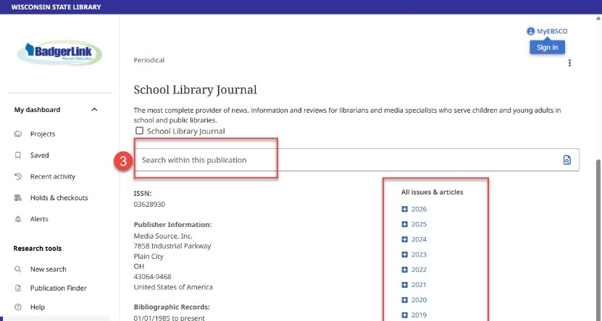
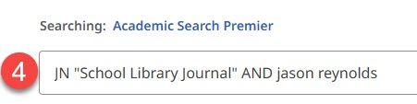


Finding Publications in EBSCO Resources
Search for publications by title in any EBSCO resource.
1. From any EBSCO resource home page, click on Publications, found in the lower left side of the page.
2. Enter the publication title in the Search Publications box and click the magnifying glass.
If the title is available in BadgerLink resources, it will appear, listing the resource and dates of coverage available.
Click the resource link to view publication record.
3. The publication record displays issues by date, or to search for a specific article or topic, click on “Search within this publication.”
4. Clicking “Search within this publication” automatically populates the search with JN “School Library Journal” which will search for articles from School Library Journal.
Provided by the Department of Public Instruction. Funding provided through the Universal Service Fund and the Institute of Museum and Library Services.

