Slide 1

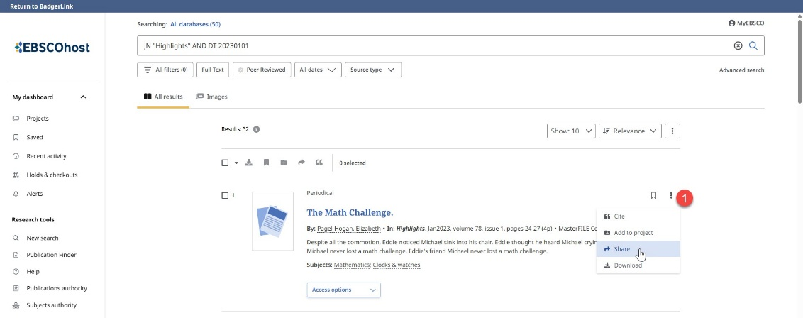
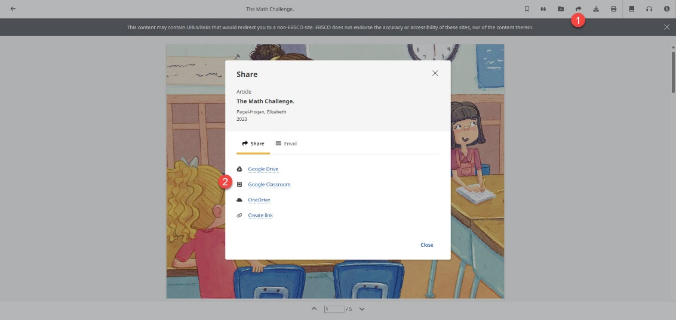
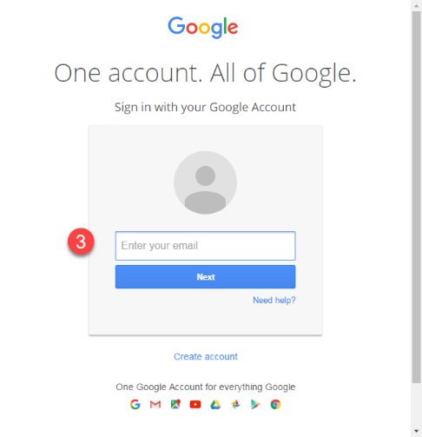
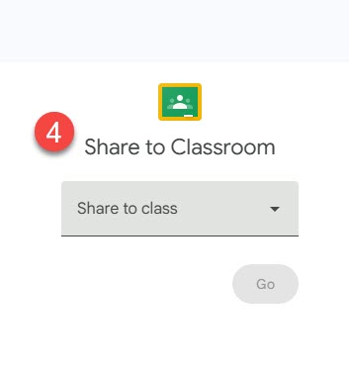


Using Google Classroom with EBSCO Resources Google Classroom is a tool that allows educators to create and organize assignments and communicate with their students. Available in EBSCOhost and Explora interfaces.
1. When you find an article in an EBSCO resource to share on Google Classroom, select the three vertical dots from search results or Access Options dropdown menu to access the Share arrow.
2. From the Share arrow, select the Google Classroom option.
3. If you are not logged in to your Google account, you will be prompted to do so.
4. Within Google Classroom, select a Class and an Action to share your article.
Please note: Students may be prompted to log in to access BadgerLink content shared in Google Classroom.
Provided by the Department of Public Instruction. Funding provided through the Universal Service Fund and the Institute of Museum and Library Services.

