Slide 1

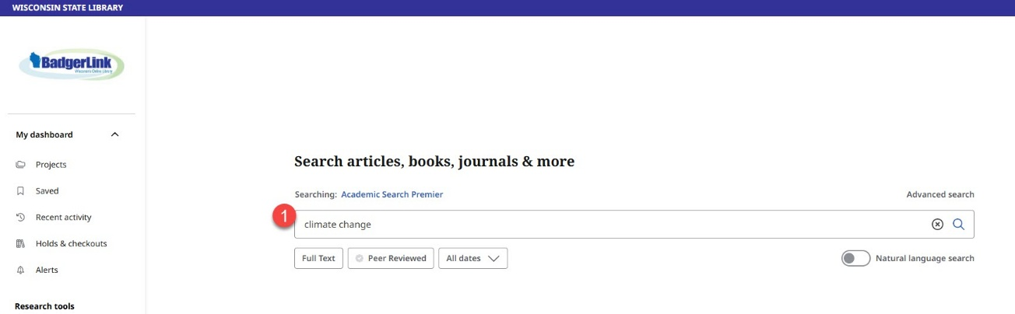
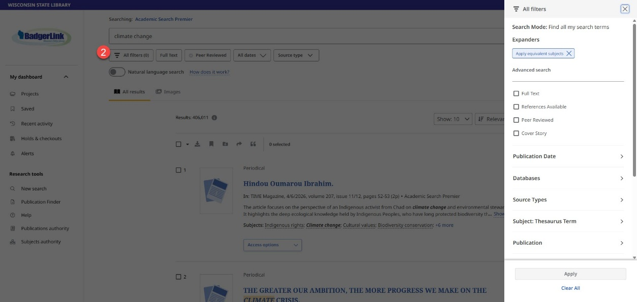
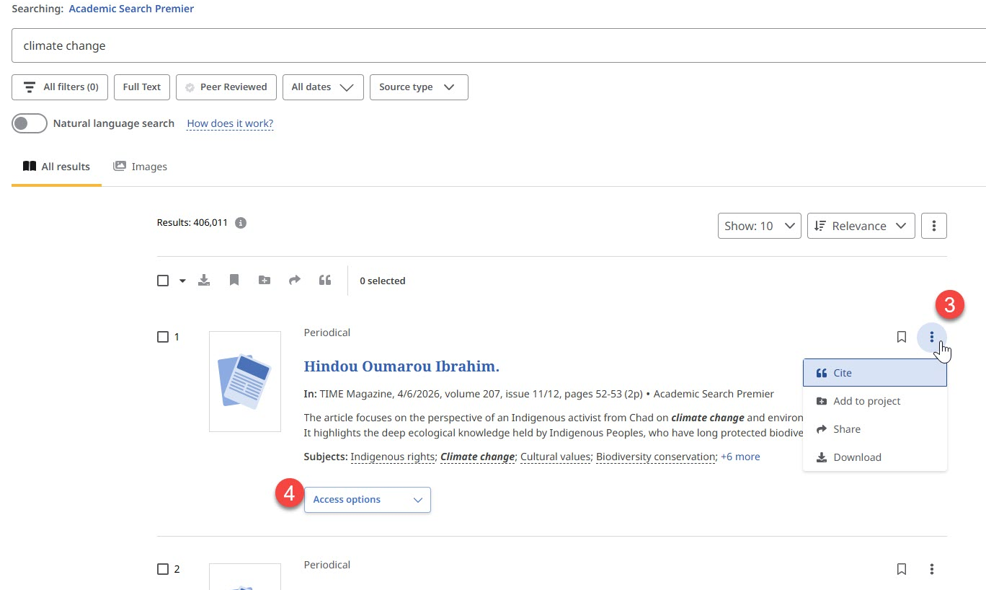


Basic Search on EBSCO Interfaces The Basic Search in EBSCOhost interface has an updated look! Select default limiters prior to search or narrow results based on many filter options to quickly find relevant research.
1. Enter your search terms in the Find field on the Basic Search screen. Tap the default filter options available under the search box, if desired. Default options include Full Text, Peer Reviewed and All Dates.
2. After selecting the magnifying glass to search, you can select the All Filters option to further narrow down results.
3. Select the three vertical dots in the upper right of an article in your search results to cite, Add to project folder, share, and download.
4. Not all articles in EBSCO resources are available in full text. In your results list, look for the Access Options dropdown menu for the available format under the article description. If there is not one, request the full text of the article through your library’s interlibrary loan service.
Provided by the Department of Public Instruction. Funding provided through the Universal Service Fund and the Institute of Museum and Library Services.

