Slide 1

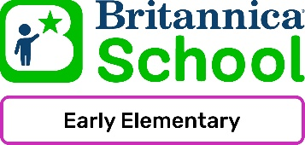
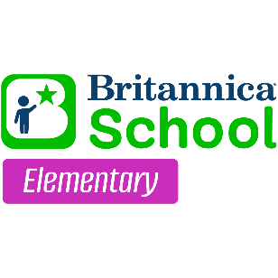


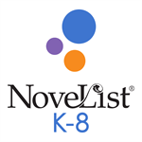


Elementary School Resource Guide Find a great collection of resources for your K-5 students!
Britannica School – Early Elementary
Learning resource collection tailored to the unique needs of Pre-K through second grade students and educators.
Details and how to use.
Britannica School - Elementary
Encyclopedia articles with images, videos, a world atlas, and other learning materials for elementary students and educators.
Details and how to use.
Britannica Escolar
Enciclopedia Espanol para los estudiantes y educadores.
Spanish encyclopedia for students and educators.
Details and how to use.
Explora for Elementary Schools
Magazines, encyclopedias, images, and reference eBooks for elementary students and educators.
Details and how to use.
NoveList K-8
Children’s fiction recommendation resource with read-alikes, discussion guides, reading lists, and more.
Details and how to use.
Provided by the Department of Public Instruction. Funding provided through the Universal Service Fund and the Institute of Museum and Library Services.

