Slide 1




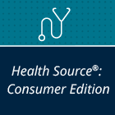
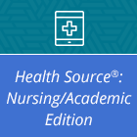
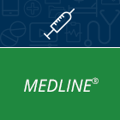


Health Resource Guide Find a great collection of resources on alternative medicine, consumer health, academic research in medical and nursing fields, and biomedical journals.
EBSCO Health Resources: Multi-database search includes Alt HealthWatch, Consumer Health Complete, Health Source: Consumer Edition, Health Source: Nursing/Academic Edition, and MEDLINE. Details and how to use.
Alt HealthWatch: Alternative health research database focused on complementary, holistic, and integrated approaches to health care and wellness. Full-text international and often peer-reviewed journals. Details and how to use.
Consumer Health Complete: Consumer-oriented health content, from mainstream to holistic medicine with full-text magazines and journals, health reference books, eBooks, and consumer health pamphlets. Details and how to use.
Health Source Consumer Edition: Consumer health information including health magazines, pamphlets, and reference books. Details and how to use.
Health Source Nursing/Academic Edition: Full-text journals for researchers, allied health professionals, nurses, and medical educators. Details and how to use.
MEDLINE: Abstracts and citations for biomedical and health journals used by health care professionals, nurses, clinicians, and researchers. Details and how to use.
Provided by the Department of Public Instruction. Funding provided through the Universal Service Fund and the Institute of Museum and Library Services.

