Slide 1

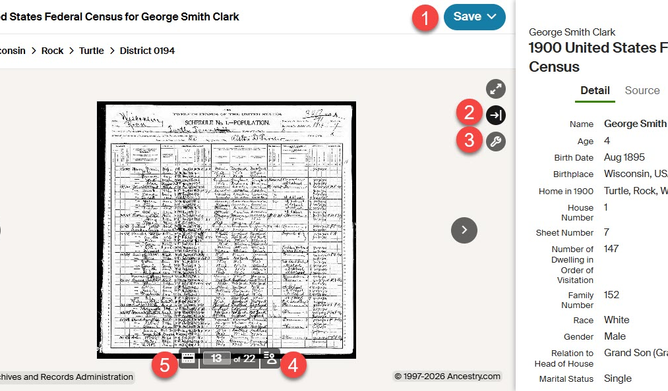


HeritageQuest Online
A comprehensive treasury of American genealogical sources including unique primary sources, local and family histories, U.S. Federal Censuses, books, cemetery records, city directories, and military records.
1. Selecting save button above the census record view allows you to select download or email options for saving image of record.
2. Selecting small button with arrow pointed to the right shows detailed information from the census record on name searched.
3. Selecting small wrench icon provides a window pop up with additional viewing options.
5. Selecting small icon of filmstrip displays additional scanned pages of census records, allowing you to navigate to other regions of the area the census records were recorded.
4. Selecting small icon in bottom right allows view of typed transcription of handwritten scan of census record, allowing for more easy reading.
Provided by the Department of Public Instruction. Funding provided through the Universal Service Fund and the Institute of Museum and Library Services.

