Slide 1




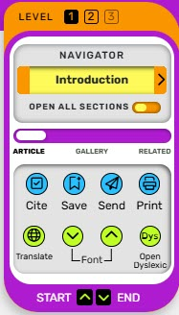
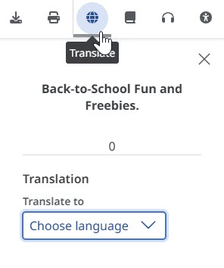
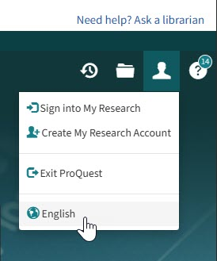



Language Translation Tools in BadgerLink Resources Many BadgerLink resources have a language translation tool, making it easy to change the resource’s interface or an article’s language with a click or two.
Select the Translation tool icon or dropdown menu in each of these resources.
Any encyclopedia article in Britannica School has the Navigator section in upper left to select Translate tool.
Any online full text article in EBSCO resources has the circular grid iron to translate from a dropdown menu of language options.
At the top of the resource’s home page, select the profile icon and click the globe to access a list of language options.
At the top of the TeachingBooks’ or TeachingBooks for Libraries’ home page, select the language from a dropdown of many language options.
Provided by the Department of Public Instruction. Funding provided through the Universal Service Fund and the Institute of Museum and Library Services.

