Slide 1

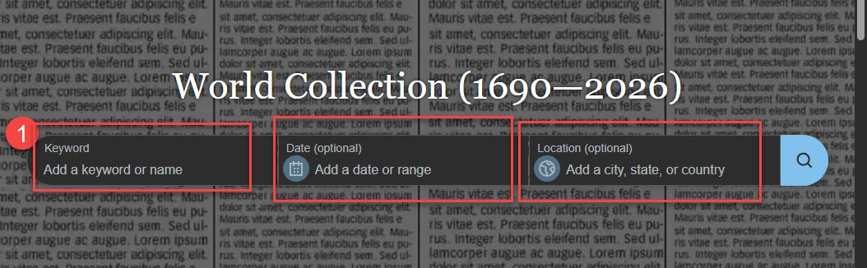
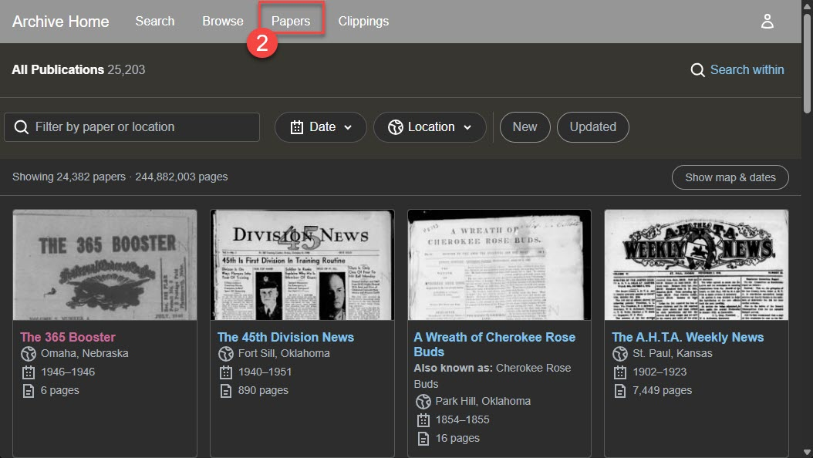
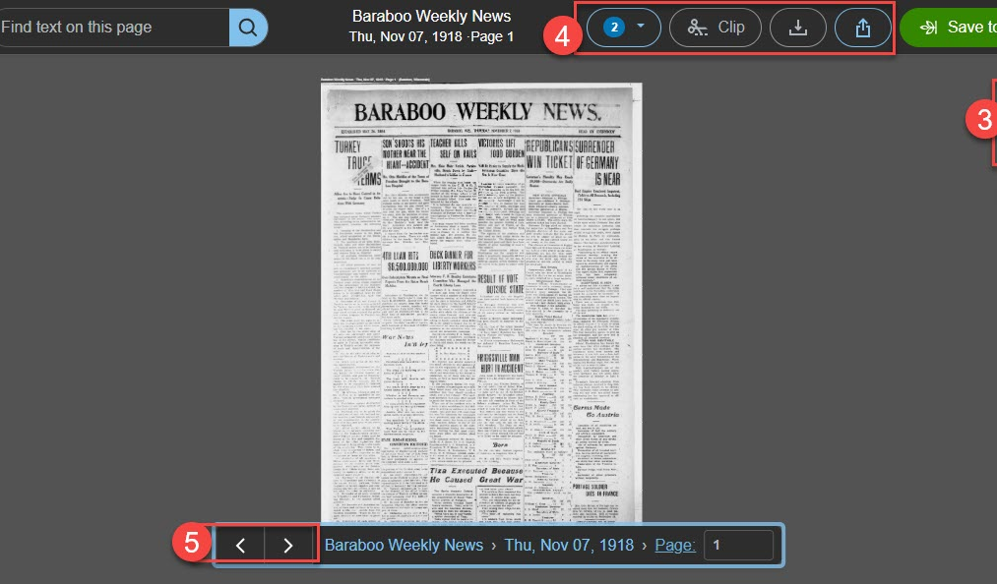


Newspaper.com Library Edition
Search historical newspapers archive from 1700s – 2000s containing thousands of well-known regional, state, and small local newspapers in the United States and other countries.
1. Upon selecting the resource, the home page provides a search box for typing in a keyword, date, and location .
2. Select Papers in the top gray bar to search for a specific newspaper title or narrow by location to see the listing by state or country.
3. Once a newspaper page has been selected, use the plus and minus signs on the right side of the page to zoom in and out.
4. Save the page or article by selecting the clip, download, or share icons.
5. Click arrow on the bottom of the page to view additional pages in the newspaper.
Provided by the Department of Public Instruction. Funding provided through the Universal Service Fund and the Institute of Museum and Library Services.

