Slide 1

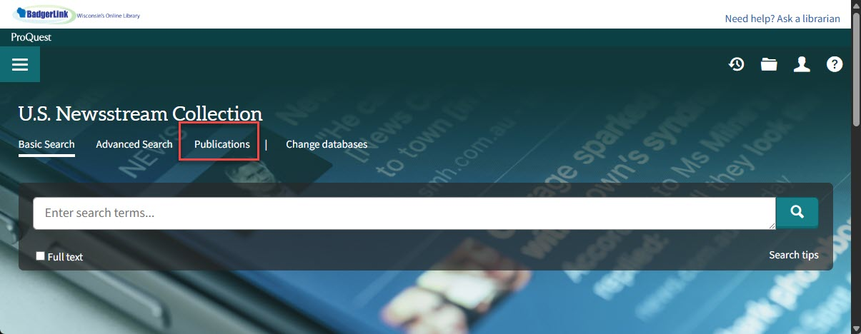
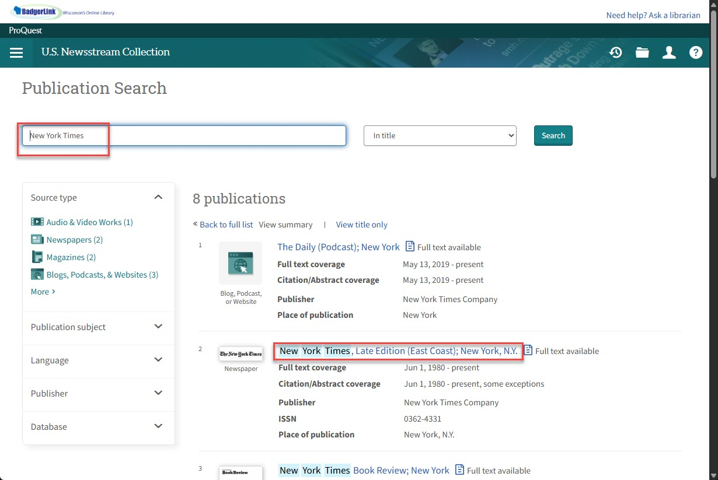
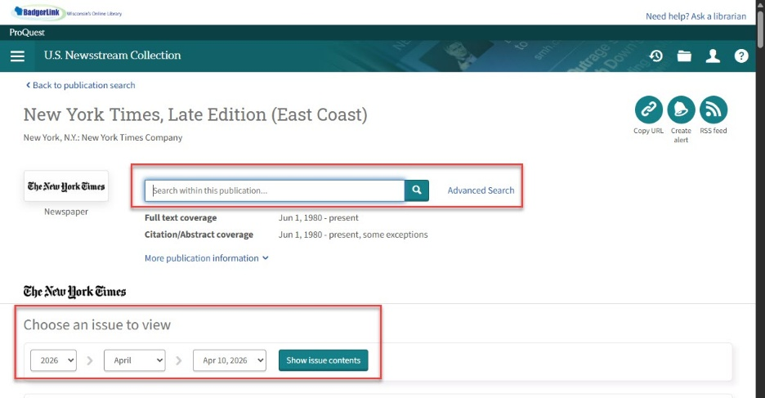


Finding Publications in U.S. Newsstream
U.S. news featuring key national and regional sources including The New York Times, The Wall Street Journal, Washington Post, Los Angeles Times, Boston Globe, Newsday, and Chicago Tribune as well as over 80 Gannett titles. Content is updated daily.
1. From the resource’s home page, select Publications at the top of the page.
2. From the Publication search, type in the name of the publication. Select Search. Select the name of the newspaper.
3. From the publication record, search within this publication by typing in a keyword or article title and selecting magnifying glass icon to search or browse specific issues by selecting date in dropdown menus for year, month and specific day.
Provided by the Department of Public Instruction. Funding provided through the Universal Service Fund and the Institute of Museum and Library Services.

